Slide 1


Slide 2
Quality Our Hallmark. N. K. LEASING & CONSTRUCTIONS LTD & GROUP of COMPANIES is the second generation entrepreneur. Today, the group enjoys a strong presence in Hyderabad and has made its position as one among the pioneers of the Building industry. They have laudable experience in executing both commercial and residential projects in their 40 years of industry standing. The systems have been strengthened and new processes have been added. Over the years they have evolved into creators of environment and is not confined to concrete structures. The group and its associates has developed residential and commercial buildings in various prime locations such as Secunderabad, Khairatabad, Gachibowli, Jubilee Hills, Sainikpuri, Kowkoor & Gandipet and also presently developing the projects at Banjara Hills, etc. The success of the group lies in its belief in clear dealings and time-bound execution. Their past ventures are a testimony to this belief. Some of the projects indeed stand out in the map of Hyderabad.
P R O F I L E

Slide 3
OUR PORTFOLIO
RESIDENTIAL apartments & LUXURY VILLAS
Commercial complex
Hospitability Conventions & Exhibitions centre

Slide 4
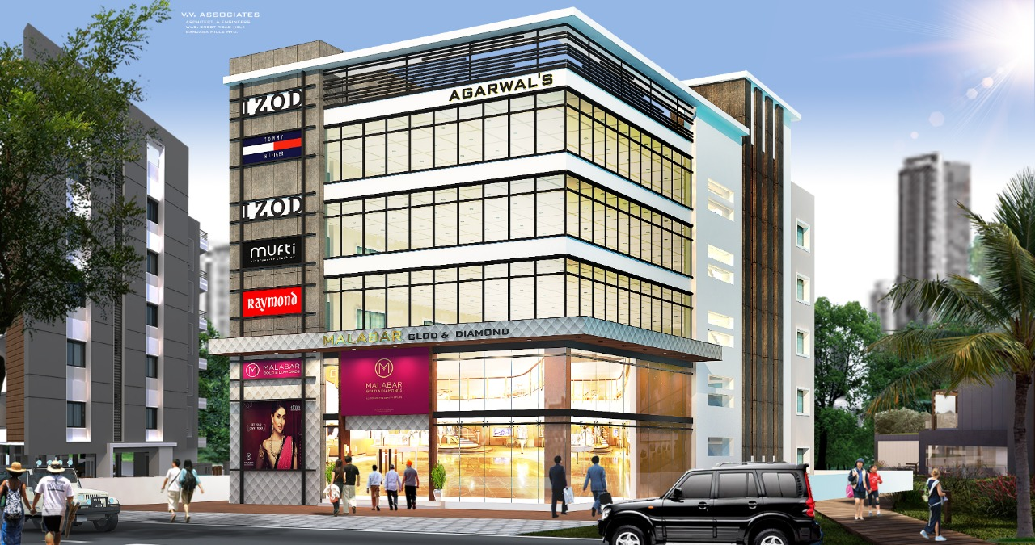
ON GOING PROJECT BY THE GROUP
COMMERCIAL COMPLEX
at Road No 12, Banjara Hills
Proposed Commercial Complex at Road No 12, Banjara Hiils

Slide 5
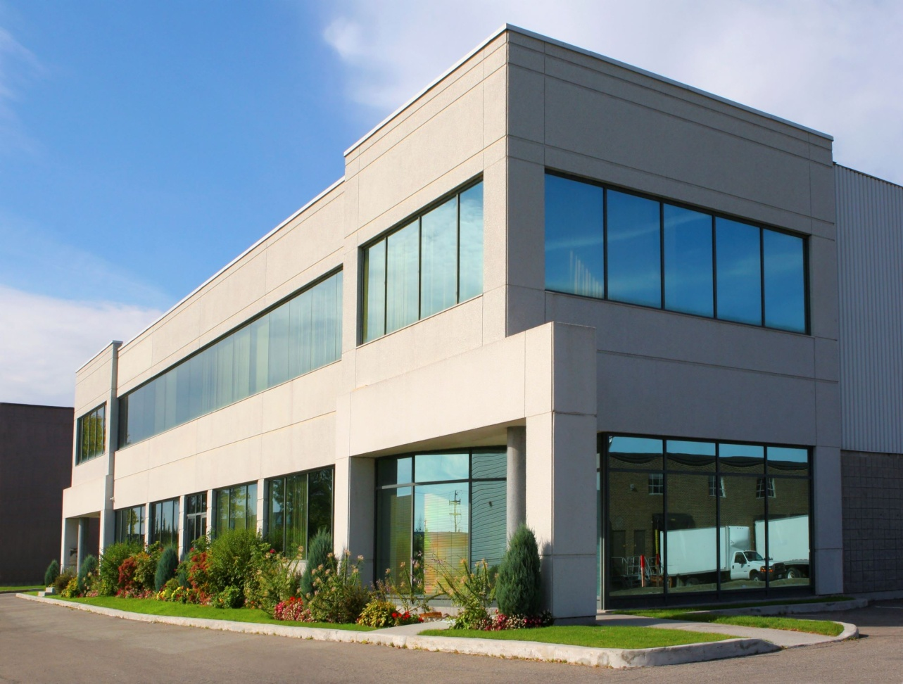
COMMERCIAL COMPLEX at Road No 10, Jubilee Hills
ON GOING PROJECT BY THE GROUP

Slide 6
FARM LANDS at BULKAPUR, R.R. DIST PLOTTED LANDS SHANKERPALLY, R.R. DIST
ON GOING PROJECT BY THE GROUP

Slide 7
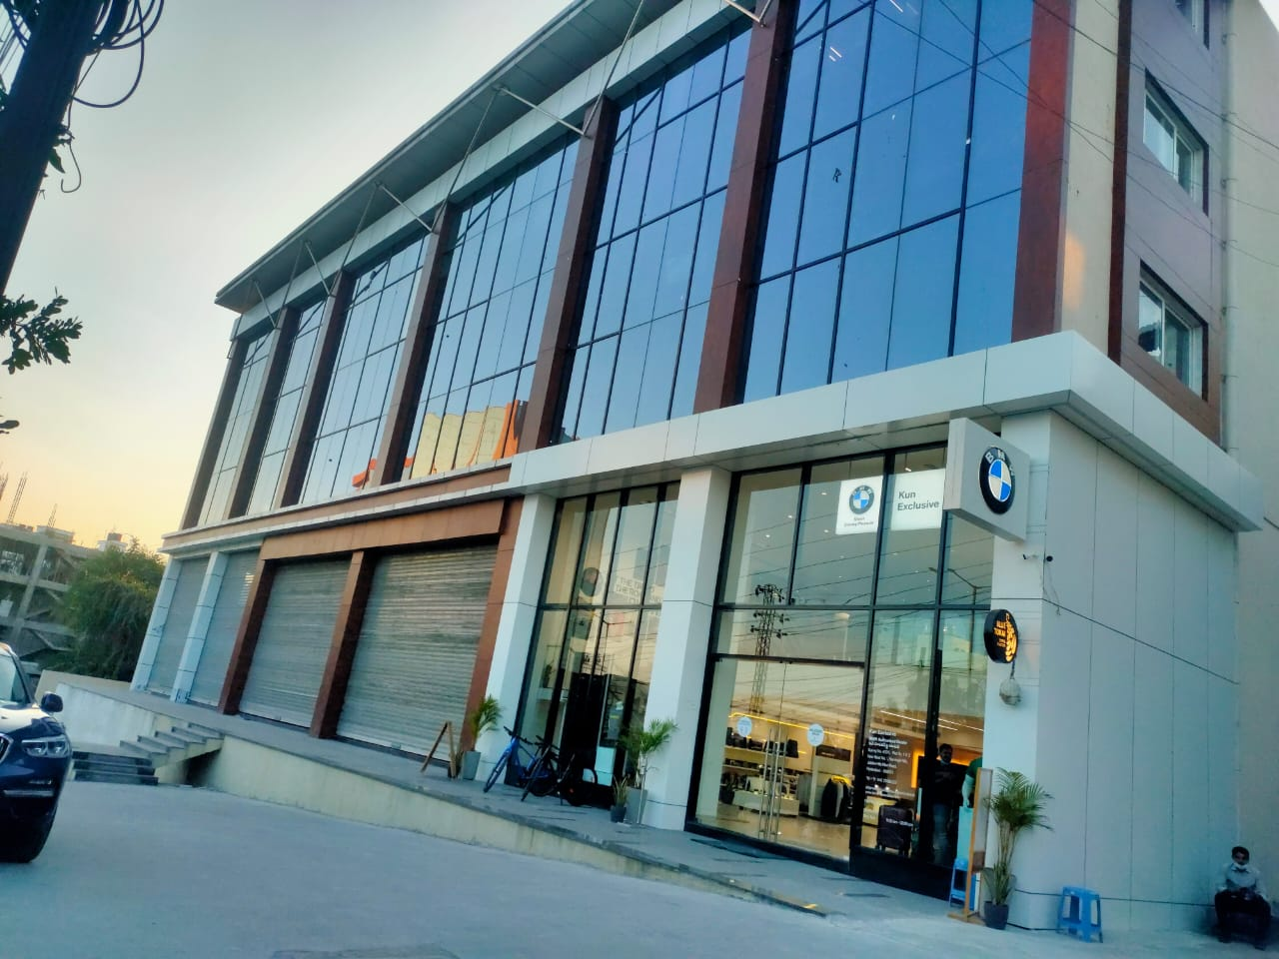
COMMERCIAL COMPLEX PARKVIEW EDIFICE at Nandagiri Hills, Jubilee Hills
PROJECT COMPLETED BY THE GROUP
PARKVIEW EDIFICE at Nandagiri Hills, Jubilee Hiils

Slide 8
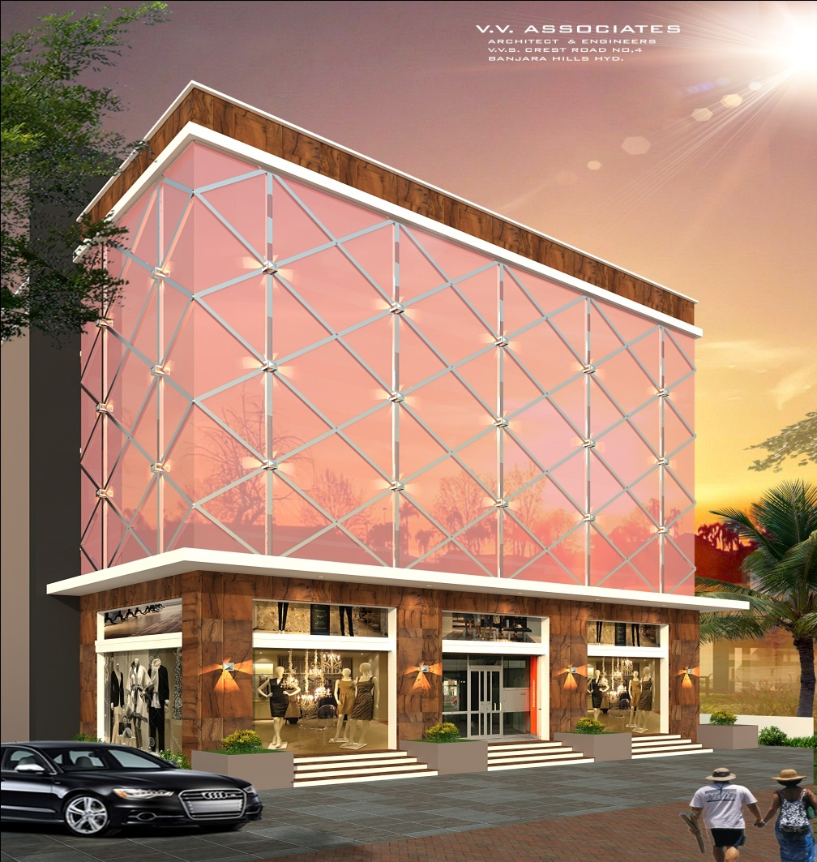
COMMERCIAL COMPLEX at Road No 45, Jubilee Hills
PROJECT COMPLETED BY THE GROUP
Commercial Complex at Road No 45, Jubilee Hiils

Slide 9
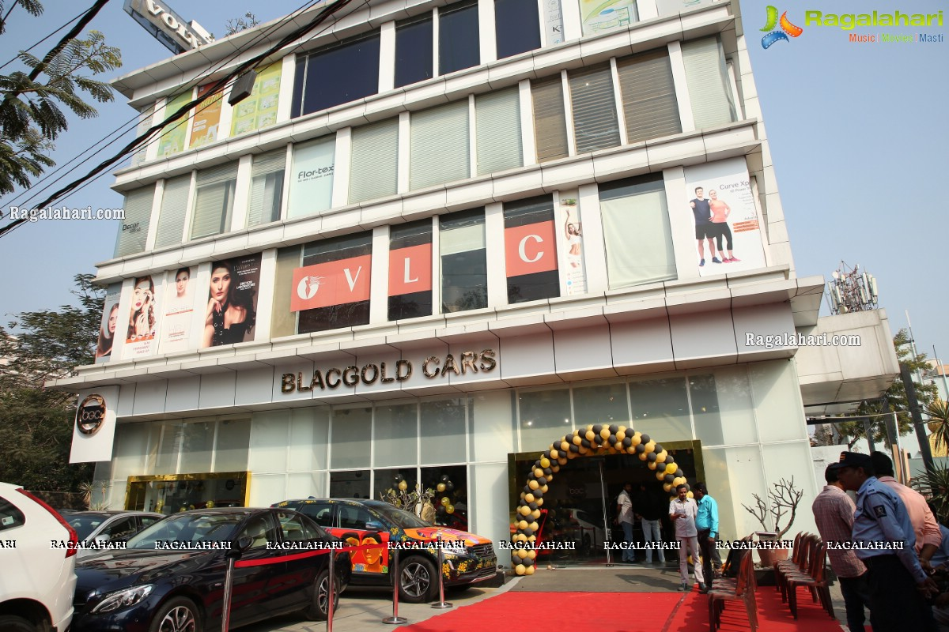
COMMERCIAL COMPLEX BANJARA EDIFICE at Road No 12, Banjara Hills
PROJECT COMPLETED BY THE GROUP
BANJARA EDIFICE at Road No 12, banjara Hiils

Slide 10
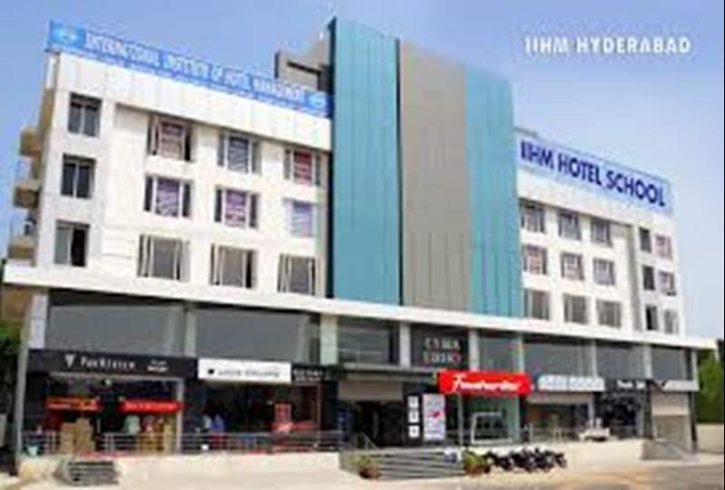
COMMERCIAL COMPLEX CYBER EDIFICE at GACHIBOWLI
PROJECT COMPLETED BY THE GROUP
CYBER EDIFICE at GACHIBOWLI

Slide 11
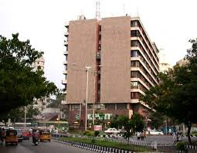
COMMERCIAL COMPLEX TARAMANDAL at IQBAL MINAR CIRCLE, SAIFABAD
PROJECT COMPLETED BY THE GROUP

Slide 12
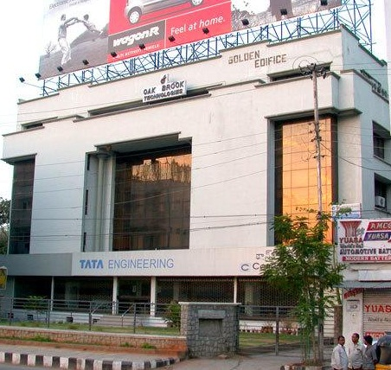
COMMERCIAL COMPLEX GOLDEN EDIFICE at KHAIRTABAD X ROADS
PROJECT COMPLETED BY THE GROUP

Slide 13
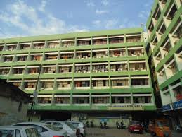
COMMERCIAL COMPLEX SURYALOK at GUNFOUNDRY, ABIDS
PROJECT COMPLETED BY THE GROUP

Slide 14
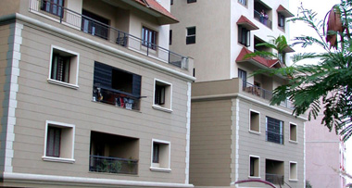
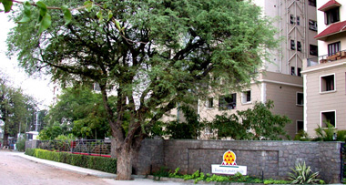
RESIDENTIAL COMPLEX VILLA HIEGHTS at BEGUMPET
PROJECT COMPLETEDBY THE GROUP

Slide 15
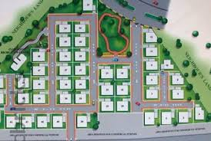
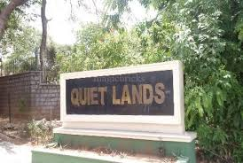
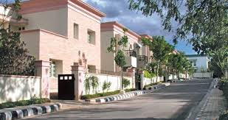
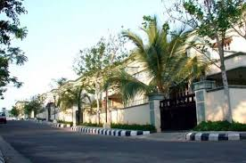
GATED COMMUNITY VILLAS QUITE LANDS at GACHIBOWLI
PROJECT COMPLETED BY THE GROUP

Slide 16
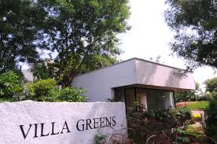
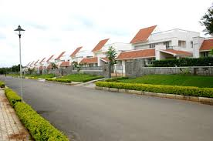
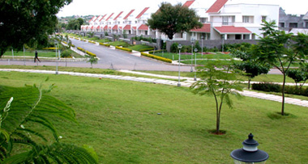
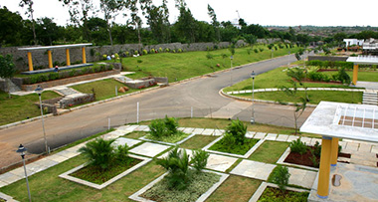
GATED COMMUNITY VILLAS VILLA GREENS at GANDIPET
PROJECT COMPLETED BY THE GROUP

Slide 17
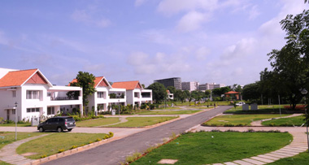
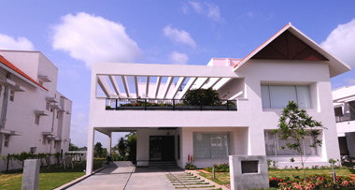
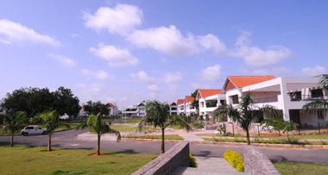
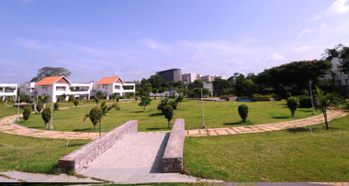
GATED COMMUNITY VILLAS FREE ZONE (SUPER DELUX VILLAS) at GANDIPET
PROJECT COMPLETED BY THE GROUP

Slide 18
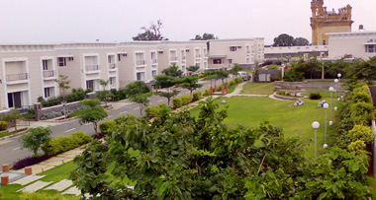
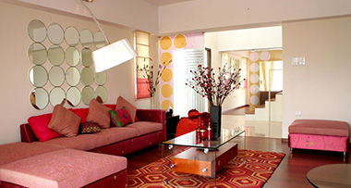
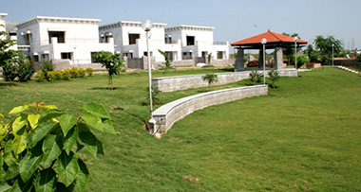
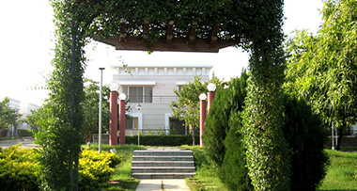
GATED COMMUNITY VILLAS VILLA SPRINGS & VILLA SPRINGS EAST at KOWKOOR
PROJECT COMPLETED BY THE GROUP

Slide 19
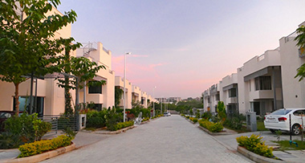
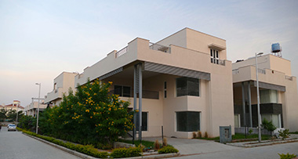
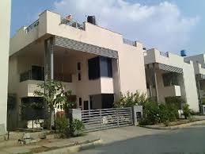
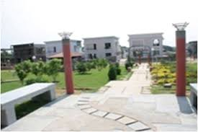
GATED COMMUNITY VILLAS VILLA SCAPES at GANDIPET
PROJECT COMPLETED BY THE GROUP

Slide 20
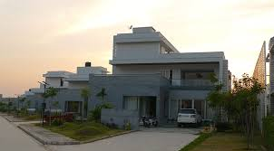
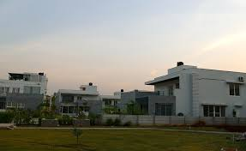
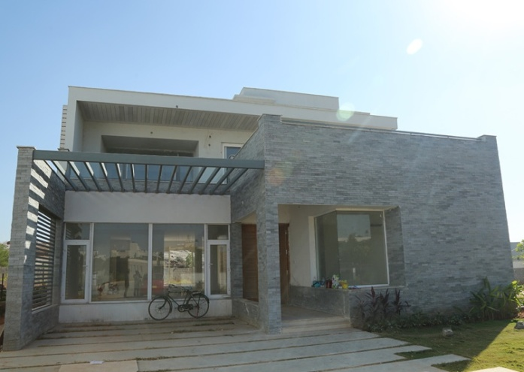

GATED COMMUNITY VILLAS SIGNATURE VILLAS (SUPER DELUX) at GANDIPET
PROJECT COMPLETED BY THE GROUP

Slide 21
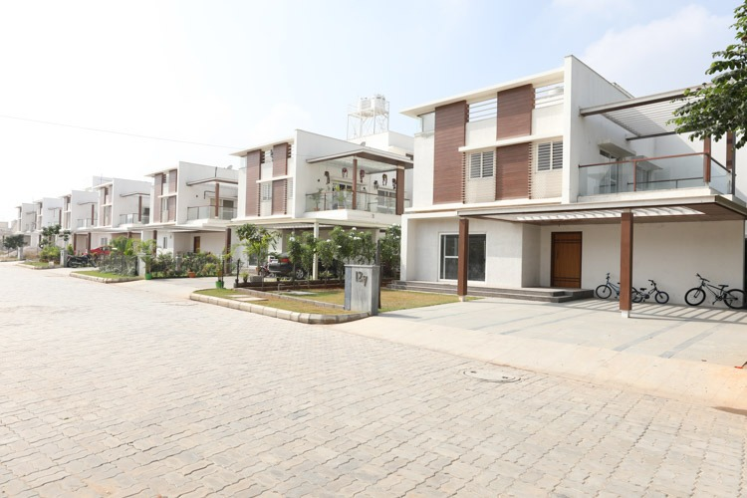
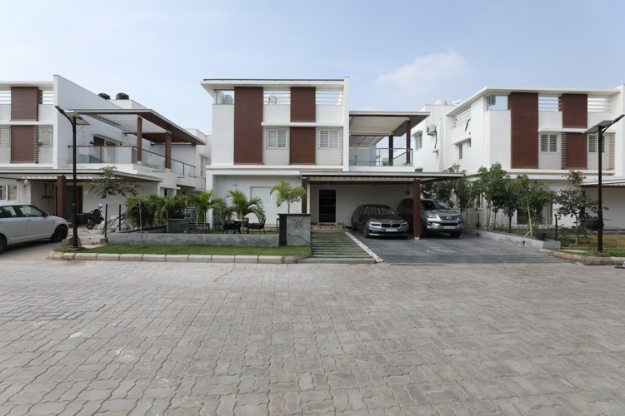
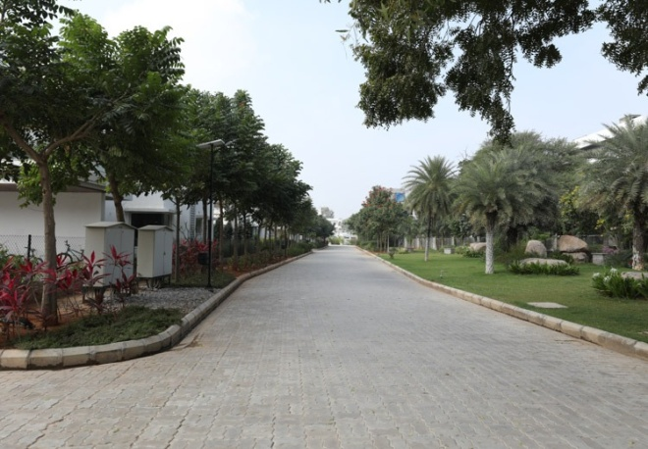
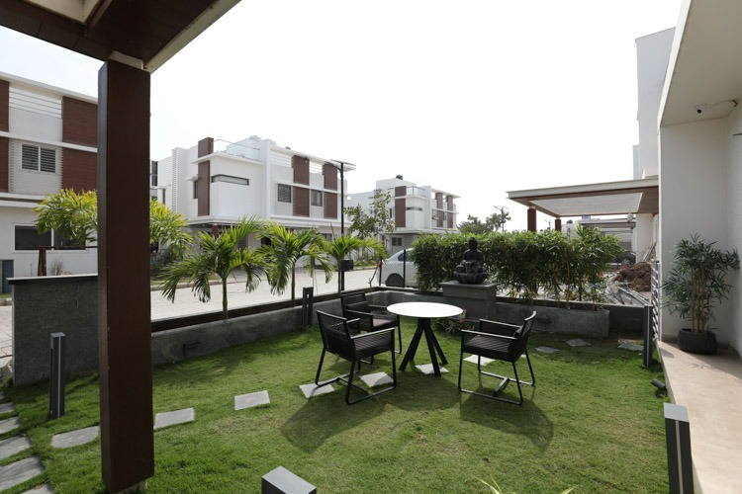
GATED COMMUNITY VILLAS URBAN VILLAS at GANDIPET
PROJECT COMPLETED BY THE GROUP

Slide 22
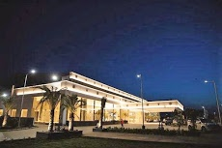
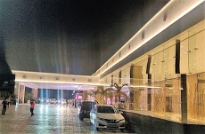
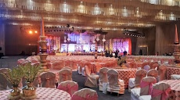
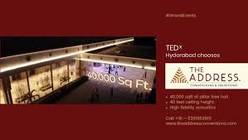
HOSPITALITY SERVICES THE ADDRESS CONVENTIONS & EXIBITIONS at NARSINGI
PROJECT COMPLETED BY THE GROUP

Slide 23
N.K. Leasing & Constructions Ltd R3ZEN,2nd Floor, Plot No.237&238, Sy.No.46, Kavuri Hills, Near D Mart, Madhapur, Hyderabad -500081 +91 4023115817, +91 4023115818 www.nklc.in
THANK YOU

